Slide 1
Computer Vision
Prof. Dr. Songül Varlı
Based on notes of CS231 in Stanford University from Andrej Karpathy, Fei-Fei Li, Justin Johnson
Optımızatıon
Regularızatıon
Dropout
Data augmentatıon
Transfer learnıng

Slide 2
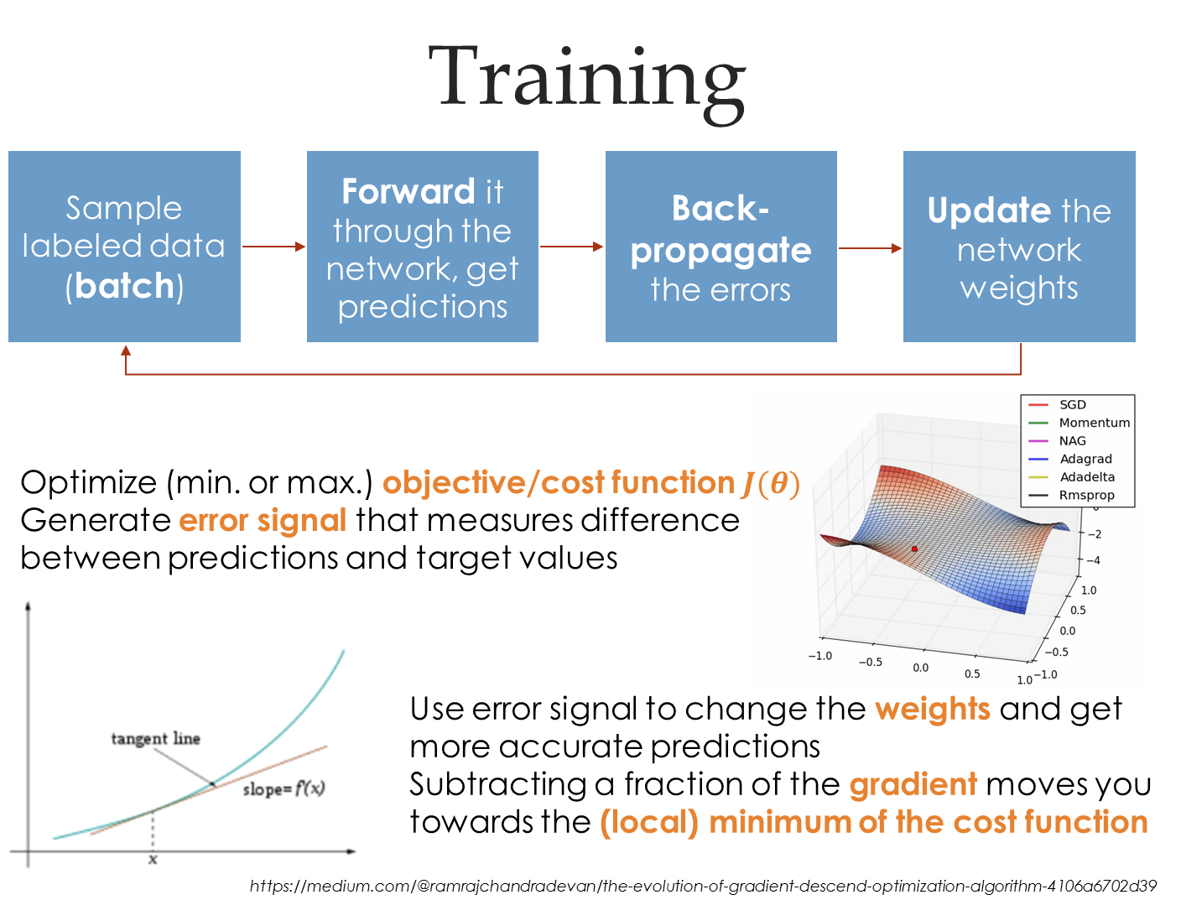

Slide 3

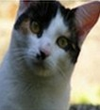
10 numbers, indicating class scores
[32x32x3]
array of numbers 0...1

Slide 4
3072x1
10x1
10x3072
10 numbers, indicating class scores
[32x32x3]
array of numbers 0...1
parameters, or “weights”

Slide 5
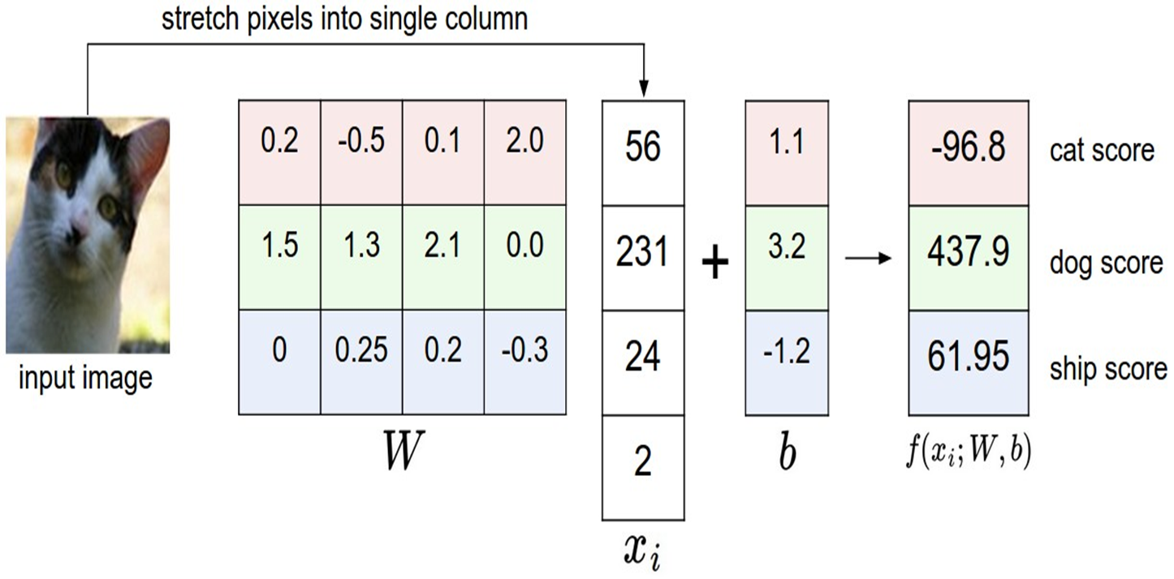

Slide 6

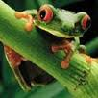
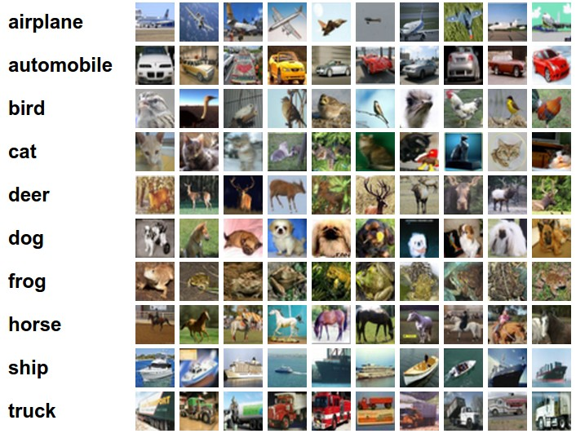
Going forward: Loss functions/optimization
TODO:
Define a loss function that quantifies our unhappiness with the scores across the training data.
Come up with a way of efficiently finding the parameters that minimize the loss function. (optimization)
-3.45
-8.87
0.09
2.9
4.48
8.02
3.78
1.06
-0.36
-0.72
-0.51
6.04
5.31
-4.22
-4.19
3.58
4.49
-4.37
-2.09
-2.93
3.42
4.64
2.65
5.1
2.64
5.55
-4.34
-1.5
-4.79
6.14

Slide 7

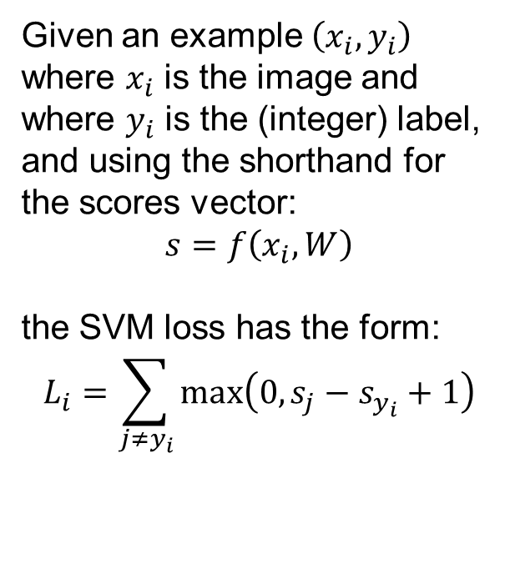
Loss functions/optimization
cat
3.2
1.3
2.2
car
5.1
4.9
2.5
frog
-1.7
2.0
-3.1

Slide 8
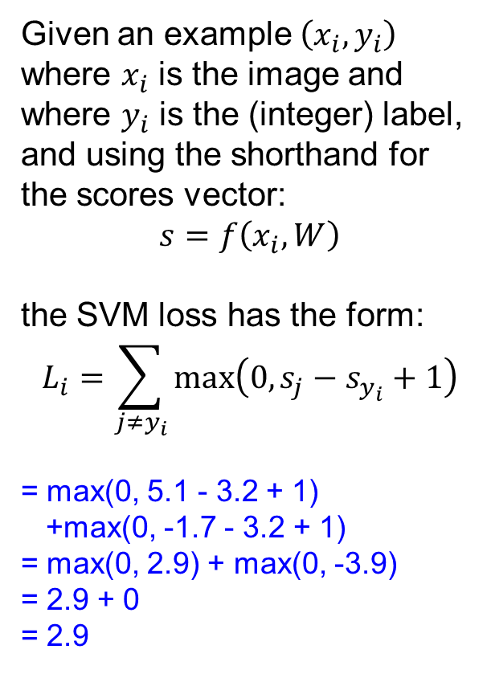
Loss functions/optimization
cat
3.2
1.3
2.2
car
5.1
4.9
2.5
frog
-1.7
2.0
-3.1
Losses:
2.9

Slide 9
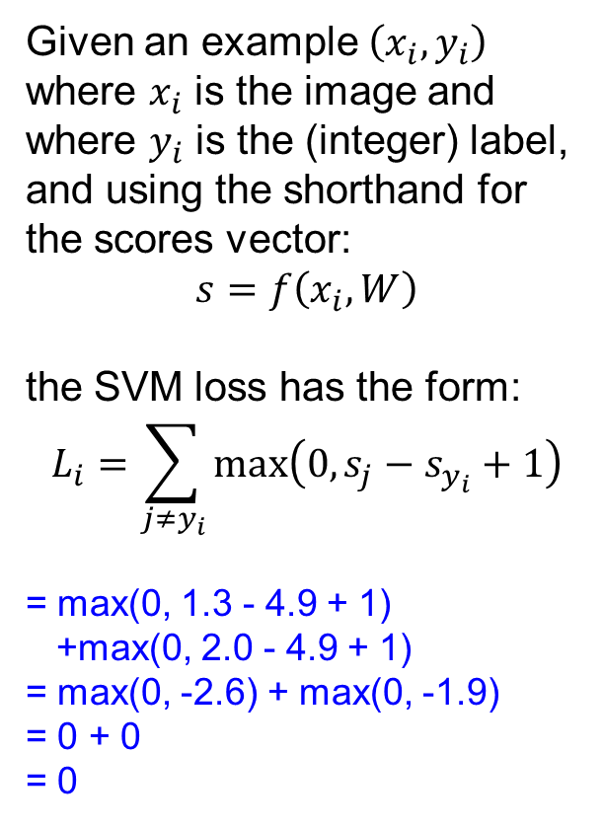
Loss functions/optimization
cat
3.2
1.3
2.2
car
5.1
4.9
2.5
frog
-1.7
2.0
-3.1
Losses:
2.9
0

Slide 10
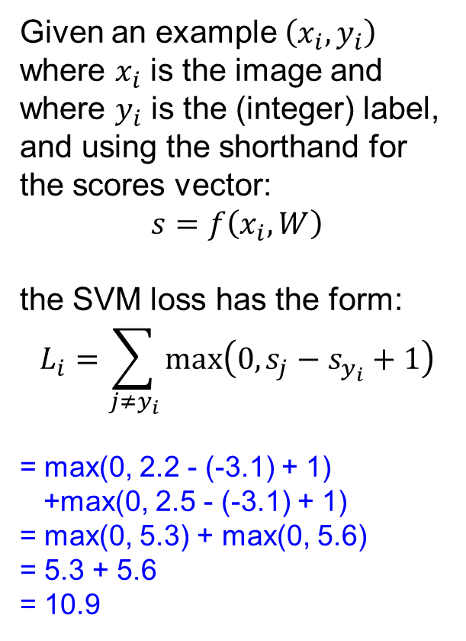
Loss functions/optimization
cat
3.2
1.3
2.2
car
5.1
4.9
2.5
frog
-1.7
2.0
-3.1
Losses:
2.9
0
10.9

Slide 11
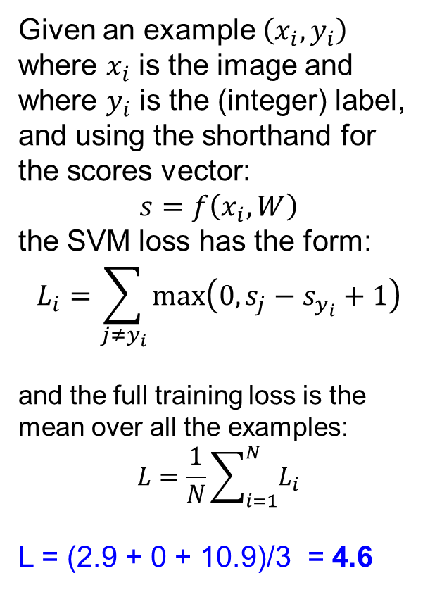
Loss functions/optimization
cat
3.2
1.3
2.2
car
5.1
4.9
2.5
frog
-1.7
2.0
-3.1
Losses:
2.9
0
10.9

Slide 12
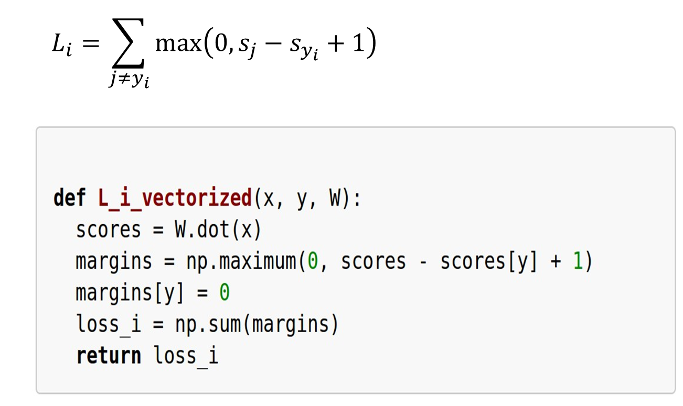
Example numpy Code

Slide 13
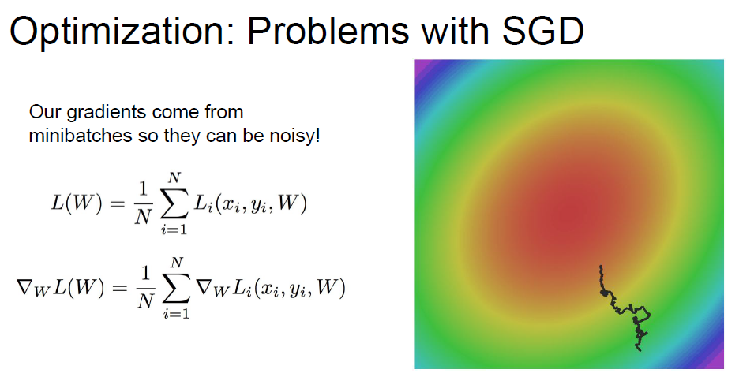
https://en.wikipedia.org/wiki/Stochastic_gradient_descent

Slide 14
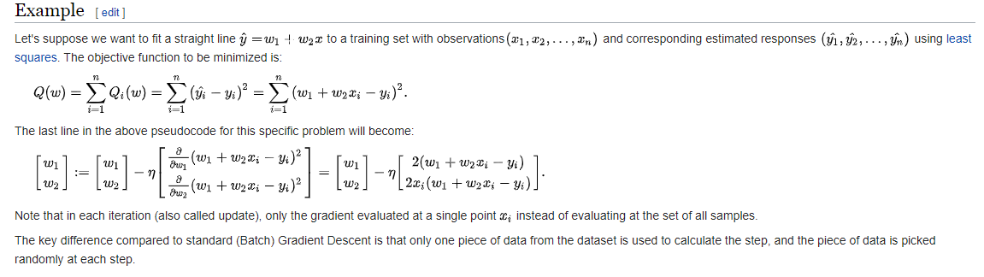
https://en.wikipedia.org/wiki/Stochastic_gradient_descent

Slide 15
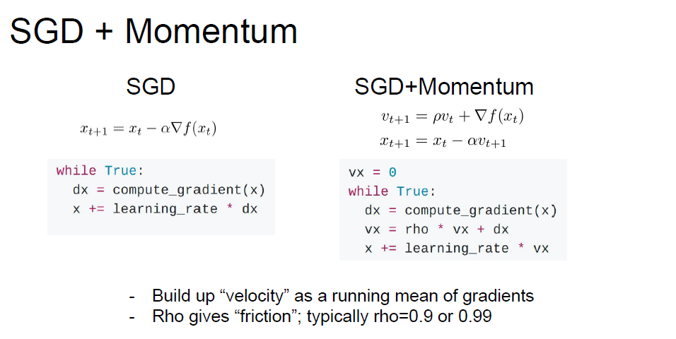

Slide 16
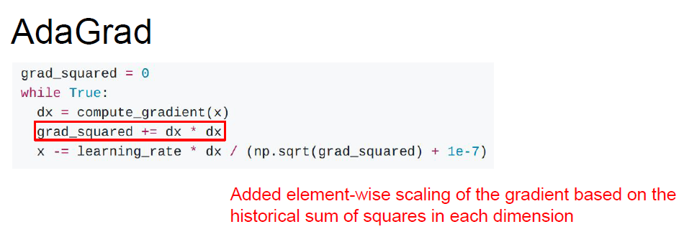

Slide 17
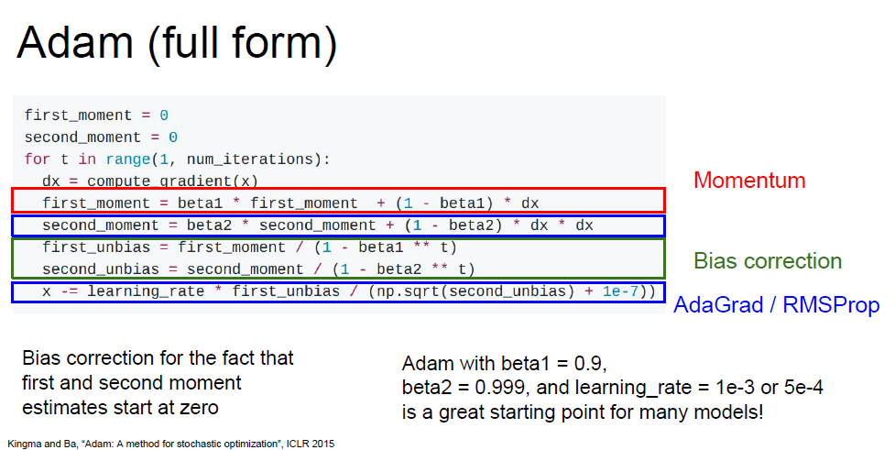
Adaptive Moment Estimation (ADAM)

Slide 18
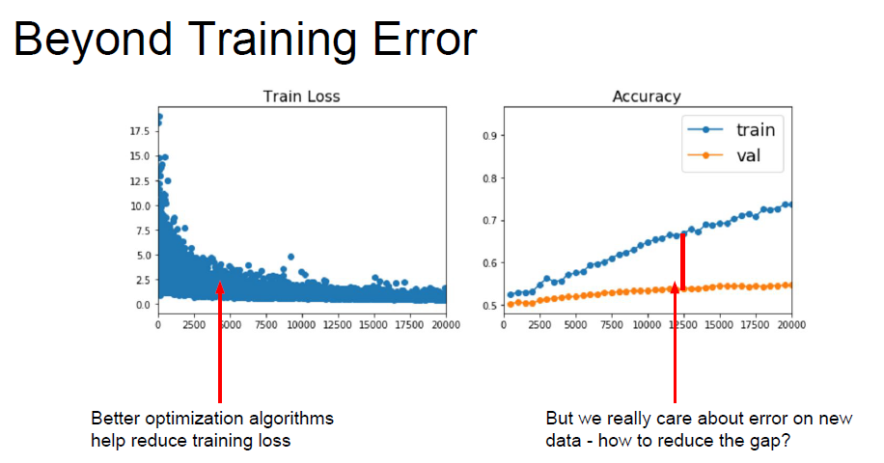

Slide 19
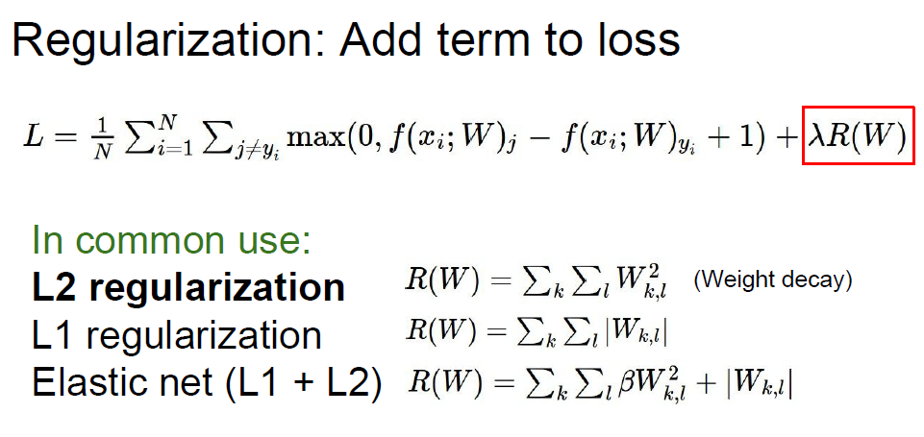

Slide 20
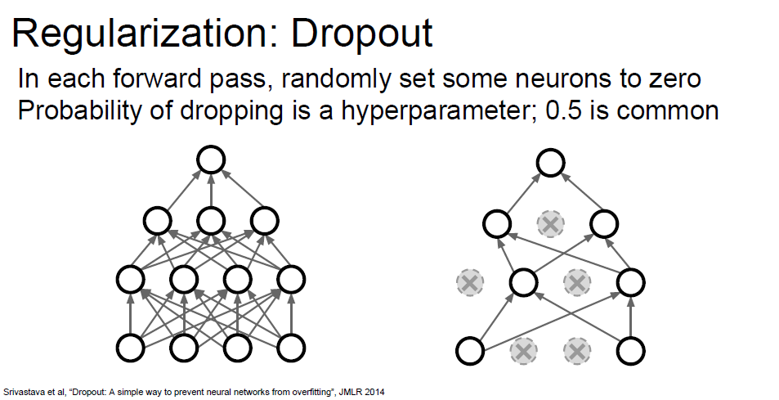
Dropout

Slide 21
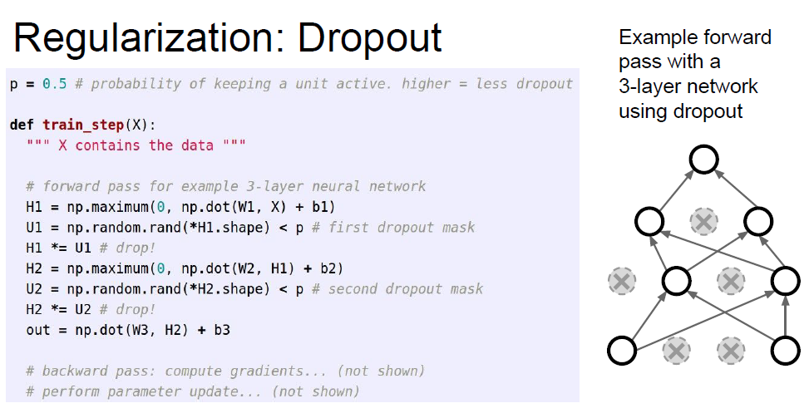

Slide 22
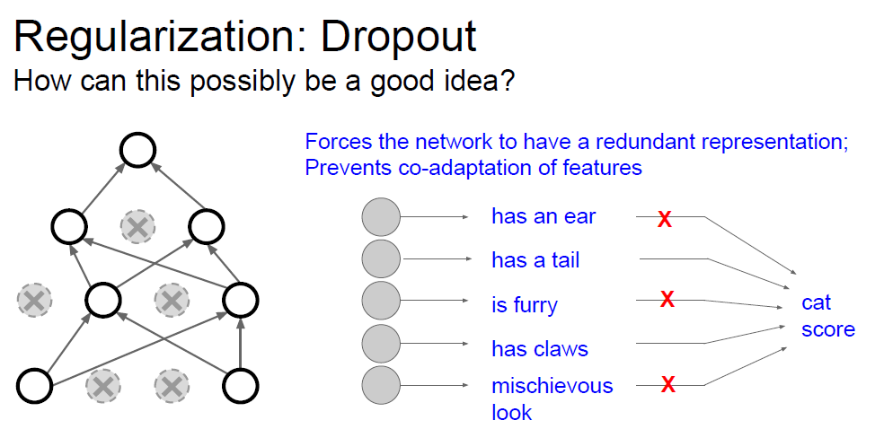

Slide 23
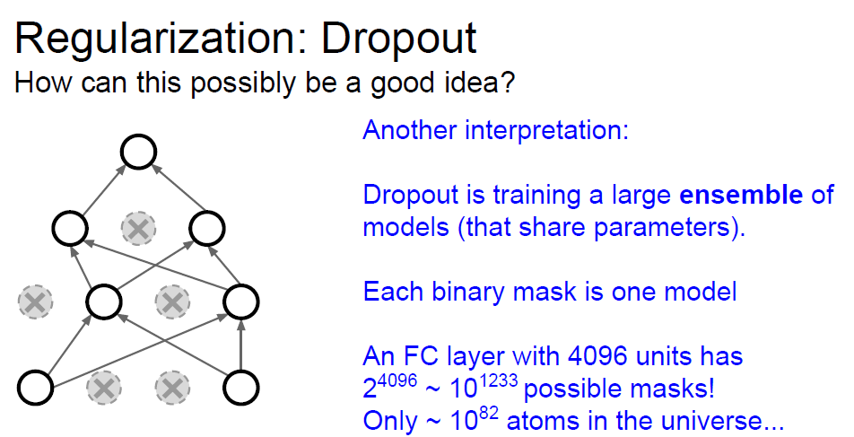

Slide 24
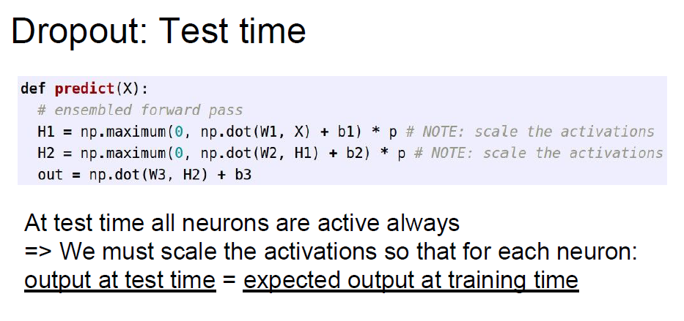

Slide 25
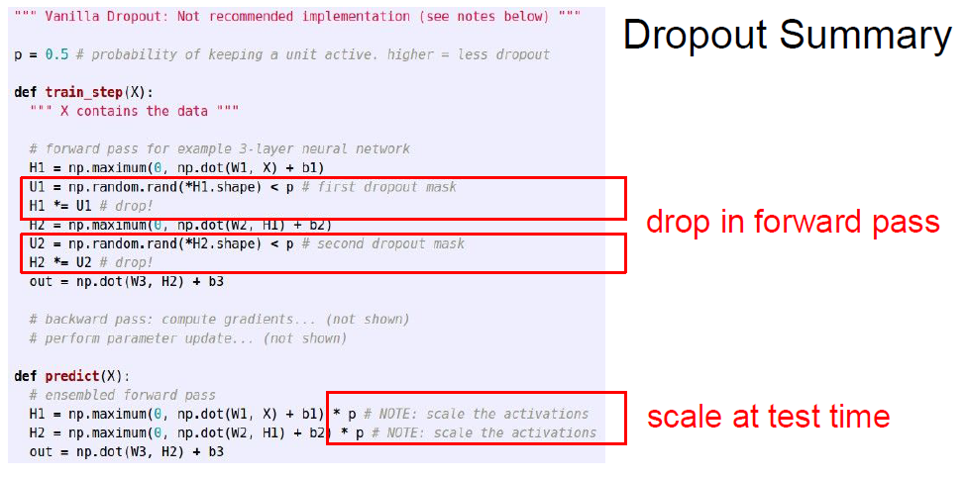

Slide 26
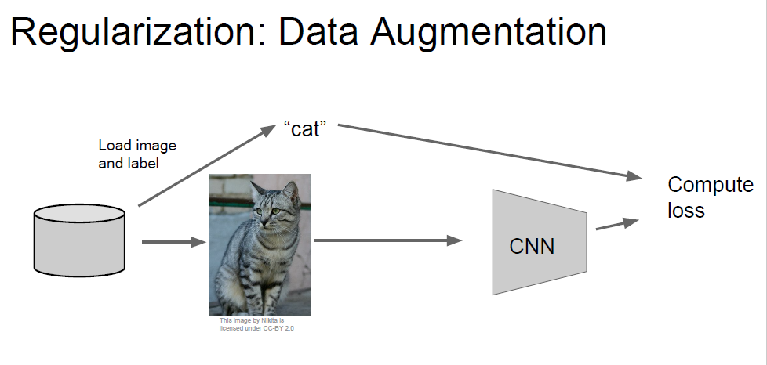

Slide 27
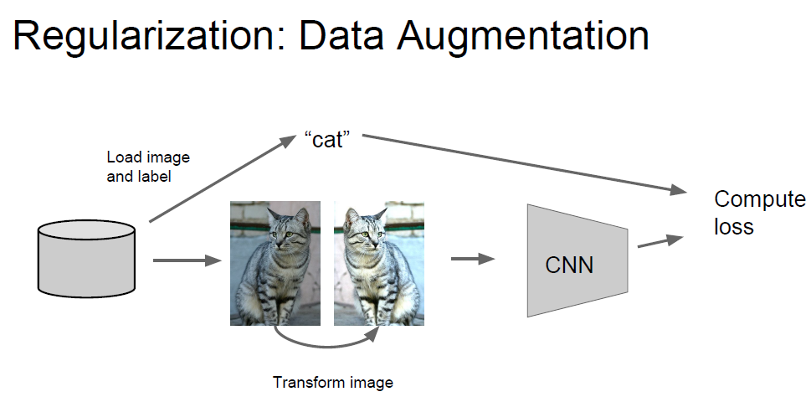

Slide 28
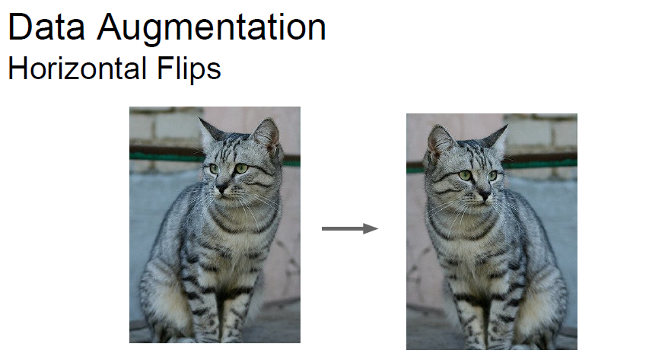

Slide 29
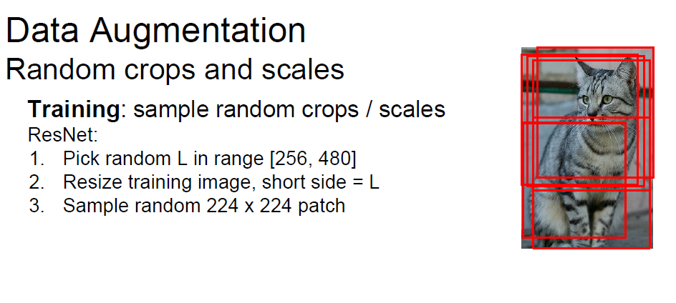

Slide 30
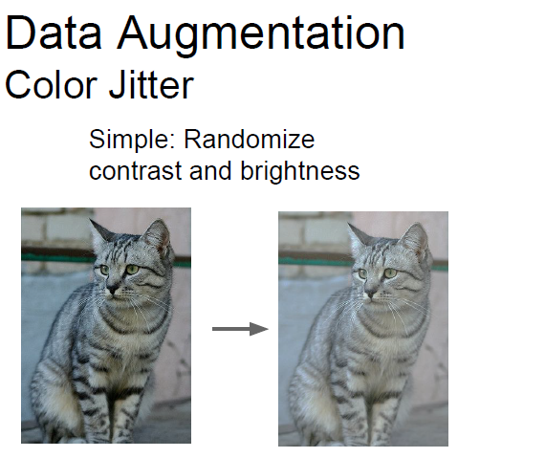

Slide 31
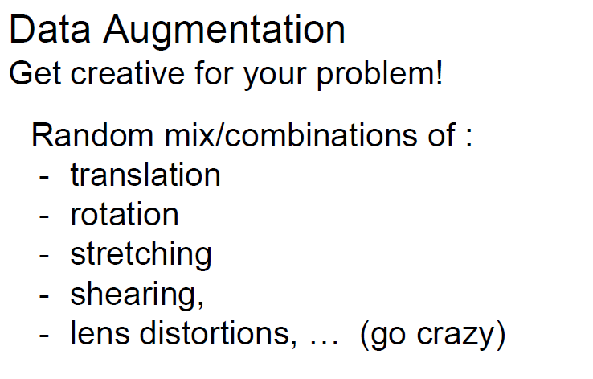

Slide 32
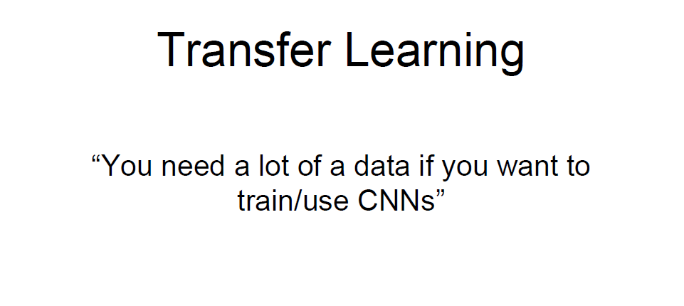

Slide 33
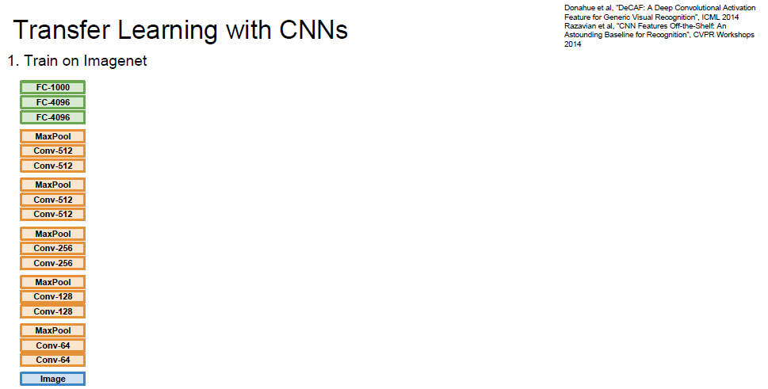

Slide 34
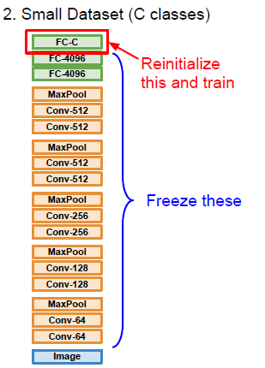

Slide 35
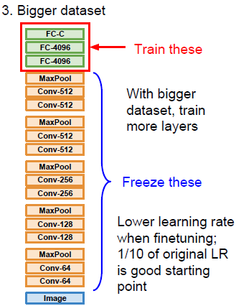

Slide 36
ImageNet Classification with Deep Convolutional Neural Networks
[Krizhevsky, Sutskever, Hinton, 2012]
“AlexNet”
Architecture:
  CONV1
  MAX POOL1
  NORM1
  CONV2
  MAX POOL2
  NORM2
  CONV3
  CONV4
  CONV5
  MAX POOL3
  FC6
  FC7
  FC8
Input: 227x227x3 images (224x224 before padding)
First layer: 96 11x11 filters applied at stride 4
Output volume size?
(N-F)/s+1 = (227-11)/4+1 = 55 -> [55x55x96]
Number of parameters in this layer?
(11*11*3)*96 = 35K

Slide 37
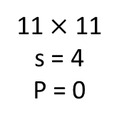
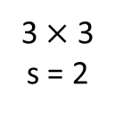
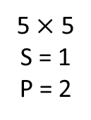
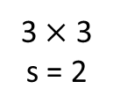




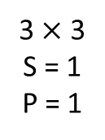
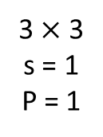
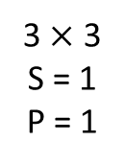
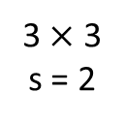
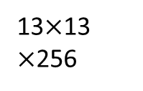




AlexNet
conv
max pool
conv
max pool
. . .
conv
conv
conv
max pool
. . .

Slide 38
AlexNet
Deep CNN architecture proposed by Krizhevsky [Krizhevsky NIPS 2012].
  5 convolutional layers (with pooling and ReLU)
  3 fully-connected layers
  won ImageNet Large Scale Visual recognition Challenge 2012
  top-1 validation error rate of 40.7%

Slide 39


AlexNet
FC
FC
. . .
Softmax
1000
4096
4096

