Slide 1
BLM1612 - Circuit Theory
The Instructors:
Dr. Öğretim Üyesi Erkan Uslu
euslu@yildiz.edu.tr
Dr. Öğretim Üyesi Hamza Osman İlhan
hoilhan@yildiz.edu.tr
Lab Assistants:
Arş. Gör. Hasan Burak Avcı
http://avesis.yildiz.edu.tr/hbavci/
Arş. Gör. Kübra Adalı
http://avesis.yildiz.edu.tr/adalik/
Arş. Gör. Alper Eğitmen
http://avesis.yildiz.edu.tr/aegitmen/

Slide 2
RC and RL Circuits
First Order Circuits

Slide 3
Objectives of Lecture
Explain the operation of a RC circuit in dc circuits
  As the capacitor stores energy when voltage is first applied to the circuit or the voltage applied across the capacitor is increased during the circuit operation.
  As the capacitor releases energy when voltage is removed from the circuit or the voltage applied across the capacitor is decreased during the circuit operation.
Explain the operation of a RL circuit in dc circuit
  As the inductor stores energy when current begins to flow in the circuit or the current flowing through the inductor is increased during the circuit operation.
  As the inductor releases energy when current stops flowing in the circuit or the current flowing through the inductor is decreased during the circuit operation.

Slide 4
Natural Response
The behavior of the circuit with no external sources of excitation.
  There is stored energy in the capacitor or inductor at time = 0 s.
  For t > 0 s, the stored energy is released
    Current flows through the circuit and voltages exist across components in the circuit as the stored energy is released.
    The stored energy will decays to zero as time approaches infinite, at which point the currents and voltages in the circuit become zero.

Slide 5
RC Circuit
Suppose there is some charge on a capacitor at time t = 0 s.
  This charge could have been stored because a voltage or current source had been in the circuit at t < 0 s, but was switched off at t = 0 s.
We can use the equations relating voltage and current to determine how the charge on the capacitor is removed as a function of time.
  The charge flows from one plate of the capacitor through the resistor R to the other plate to neutralize the charge on the opposite plate of the capacitor.

Slide 6
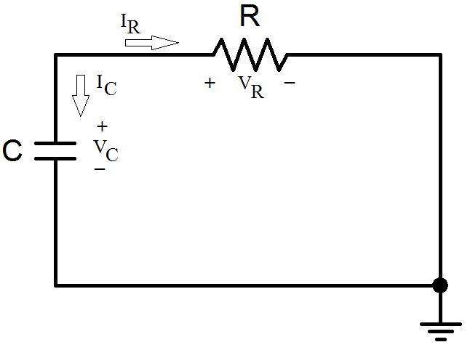
Equations for RC Circuit

Slide 7
Equations for RC Circuit
Since the voltages are equal and the currents have the opposite sign, the power that is dissipated by the resistor is the power that is being released by the capacitor.

Slide 8
The Key to Working with a Source-Free RC Circuit Is Finding:
The initial voltage v(0) = V₀ across the capacitor.
  Can be obtained by inserting a d.c. source to the circuit for a time much longer than τ (at least t = -5τ) and then removing it at t = 0.
    Capacitor
      Open Circuit Voltage
The time constant τ.
  In finding the time constant τ = RC, R is often the Thevenin equivalent resistance at the terminals of the capacitor;
    that is, we take out the capacitor C and find R = R_{Th} at its terminals

Slide 9
Time constant
The natural response of a capacitive circuit refers to the behavior (in terms of voltages) of the circuit itself, with no external sources of excitation.
  The natural response depends on the nature of the circuit alone, with no external sources.
    In fact, the circuit has a response only because of the energy initially stored in the capacitor.
The voltage response of the RC circuit
  Time constant, τ = RC
    The time required for the voltage across the capacitor to decay by a factor of 1/e or 36.8% of its initial value.

Slide 10
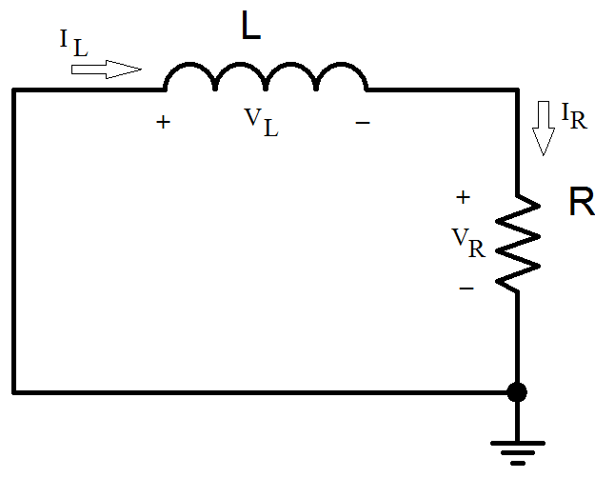
Equations for RL Circuits

Slide 11
Equations for RL Circuit
Since the voltages are equal and the currents have the opposite sign, the power that is dissipated by the resistor is the power that is being released by the inductor.

Slide 12
The Key to Working with a Source-Free RL Circuit Is Finding:
The initial current i(0) = I₀ through the inductor.
  Can be obtained by inserting a d.c. source to the circuit for a time much longer than τ (at least t = -5τ) and then removing it at t = 0.
    Inductor
      Short Circuit Current
The time constant τ.
  In finding the time constant τ = L/R, R is often the Thevenin equivalent resistance at the terminals of the inductor;
    that is, we take out the inductor L and find R = R_{Th} at its terminals

Slide 13
Time constant
The natural response of an inductive circuit refers to the behavior (in terms of currents) of the circuit itself, with no external sources of excitation.
  The natural response depends on the nature of the circuit alone, with no external sources.
    In fact, the circuit has a response only because of the energy initially stored in the inductor.
The current response of the RL circuit
  Time constant, τ =L/R
    The time required for the current in the inductor to decay by a factor of 1/e or 36.8% of its initial value.

Slide 14
Singularity Functions
Singularity functions (also called switching functions) are very useful in circuit analysis.
They serve as good approximations to the switching signals that arise in circuits with switching operations.
They are helpful in the neat, compact description of some circuit phenomena,
  especially the step response of RC or RL circuits
Singularity functions are functions that either are discontinuous or have discontinuous derivatives.

Slide 15
Unit Step Function
The unit step function (u(t)) is 0 for negative values of t and 1 for positive values of t.
v(t)
V₀

Slide 16
Unit Step Function
Voltage source of V₀u(t) and its equivalent circuit.
Current source of I₀u(t) and its equivalent circuit.

Slide 17
Unit Impulse Function
The derivative of the unit step function u(t) is the unit impulse function (δ(t))
x(t) = 5δ(t+2) + 10δ(t) - 4δ(t-3)

Slide 18
Integration of Unit Functions
To illustrate how the impulse function affects other functions, let us evaluate the integral
This is a highly useful property of the impulse function known as the sampling or sifting property.

Slide 19
Unit Ramp Function

Slide 20
Relationships of singularity functions
The three singularity functions (impulse, step, and ramp) are related by differentiation as
or by integration as

Slide 21
Transient responses of RC and RL circuits
AKA a forced response to an independent source
Capacitor and inductor store energy when there is:
  a transition in a unit step function source, u(t-to)
  a voltage or current source is switched into the circuit.

Slide 22
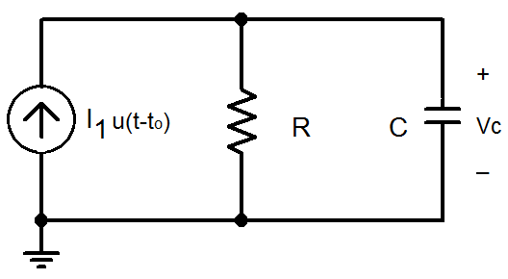
RC Circuit
I_{C} = 0A when t < t_{o}
V_{C} = 0V when t < t_{o}
Because I₁ = 0A (replace it with an open circuit).

Slide 23
RC Circuit
Find the final condition of the voltage across the capacitor.
  Replace C with an open circuit and determine the voltage across the terminal.
I_{C} = 0A when t ~ ∞ s
V_{C} = V_{R} = I₁R when t ~ ∞ s

Slide 24
RC Circuit
In the time between t_{o} and t = ∞ s, the capacitor stores energy and currents flow through R and C.

Slide 25
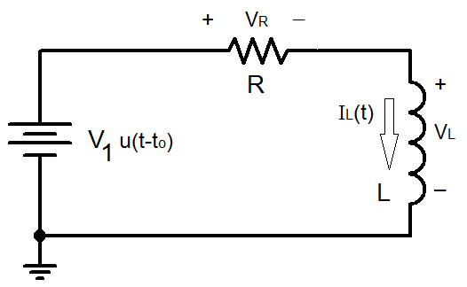
RL Circuit

Slide 26
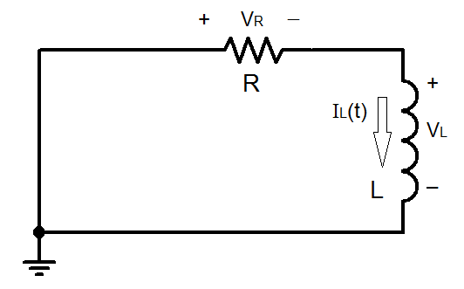
RL Circuit
Initial condition is not important as the magnitude of the voltage source in the circuit is equal to 0V when t ≤ t_{o}.
  Since the voltage source has only been turned on at t = t_{o}, the circuit at t ≤ t_{o} is as shown on the left.
    As the inductor has not stored any energy because no power source has been connected to the circuit as of yet, all voltages and currents are equal to zero.

Slide 27
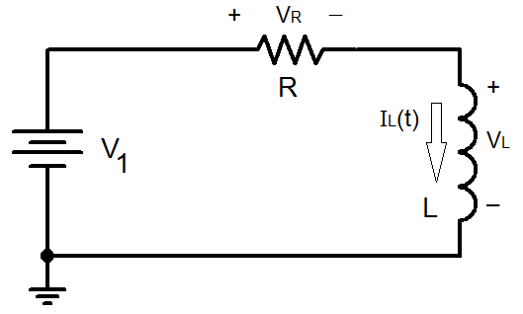
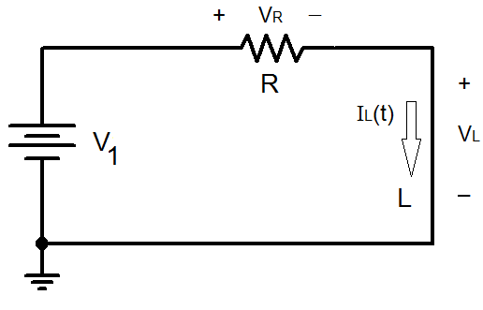
RL Circuit
So, the final condition of the inductor current needs to be calculated after the voltage source has switched on.
  Replace L with a short circuit and calculate I_{L}(∞).

Slide 28
Final Condition

Slide 29
RL Circuit

Slide 30
Complete Response
Is equal to the natural response of the circuit plus the forced response
  Use superposition to determine the final equations for voltage across components and the currents flowing through them.
Typically, it is assumed that the currents and voltages in a circuit have reached steady-state once 5τ have passed after a change has been made to the value of a current or voltage source in the circuit.

Slide 31
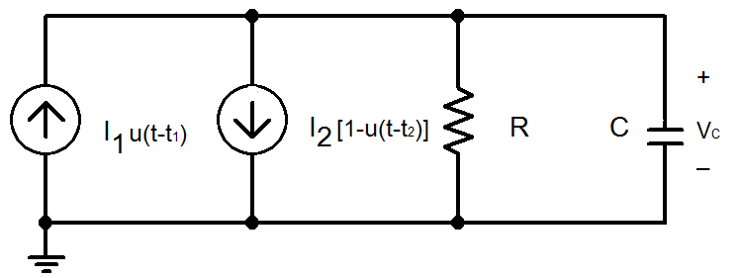
Example 01…
Suppose there were two unit step function sources in the circuit.

Slide 32
…Example 01…
The solution for Vc would be the result of superposition where:
  I₂ = 0A, I₁ is left on
    The solution is a forced response since I₁ turns on at t = t₁
  I₁ = 0A, I₂ is left on
    The solution is a natural response since I₂ turns off at t = t₂

Slide 33
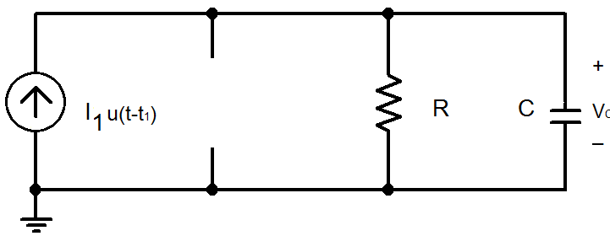
…Example 01…

Slide 34
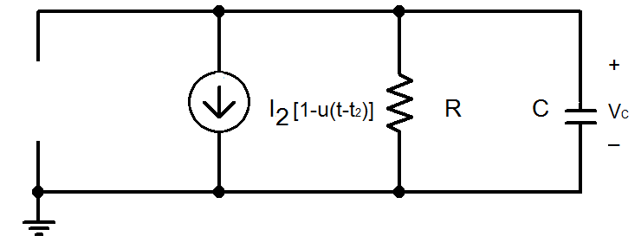
…Example 01…

Slide 35
…Example 01…
If t₁ < t₂

Slide 36
General Equations
When a voltage or current source changes its magnitude at t = 0s in a simple RC or RL circuit.
  Equations for a simple RC circuit
  Equations for a simple RL circuit

Slide 37
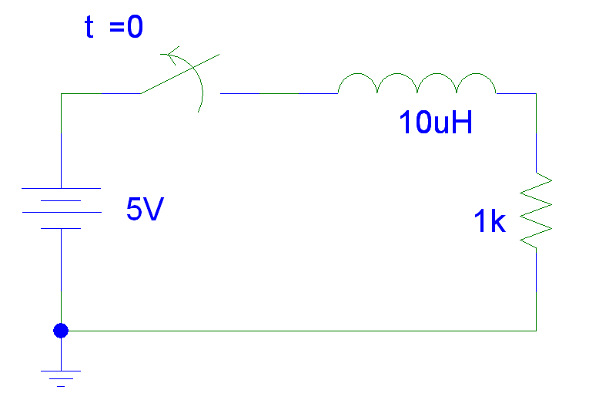
Example 02…
t < 0
V_{L} = 0V
V_{R} = 5V
I_{L} = I_{R} = 5mA
V(t) = 5V [1 - u(t)]

Slide 38
…Example 02
t > 0
τ = L/R = 10mH/1kΩ = 10 ns
I_{L} = I_{R} = i(0)e^{-t/τ} = 5mA e^{-t/10ns}
V_{R} = 1kΩ I_{R} = 5V e^{-t/10ns}
V_{L} = L(dI_{L}/dt) = -5V e^{-t/10ns}
Note V_{R} + V_{L} = 0 V
V(t) = 5V [1 - u(t)]

Slide 39
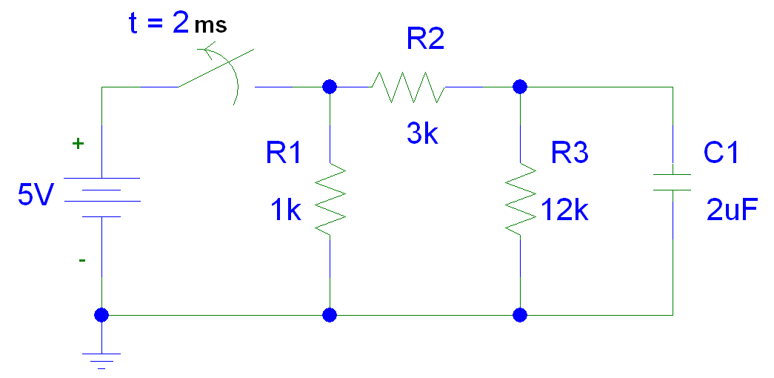
Example 03…
V(t) = 5V [1 - u(t - 2ms)]

Slide 40
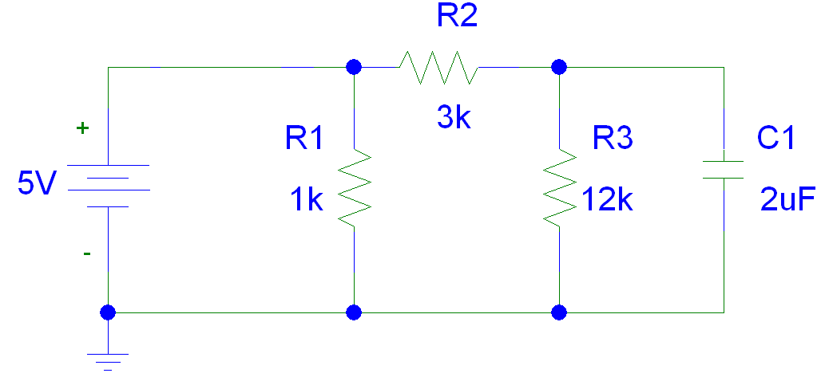
…Example 03…
t < 2ms

Slide 41
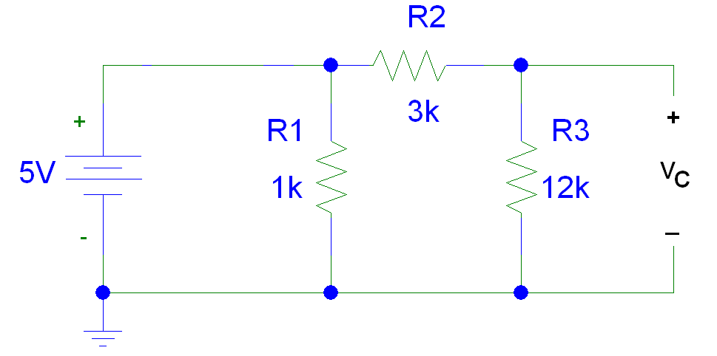
…Example 03…
t < 2ms
  C1 is an open.
    The voltage across the capacitor is equal to the voltage across the 12kΩ resistor.
  V_{C} = [12kΩ /15kΩ] 5V = 4V

Slide 42
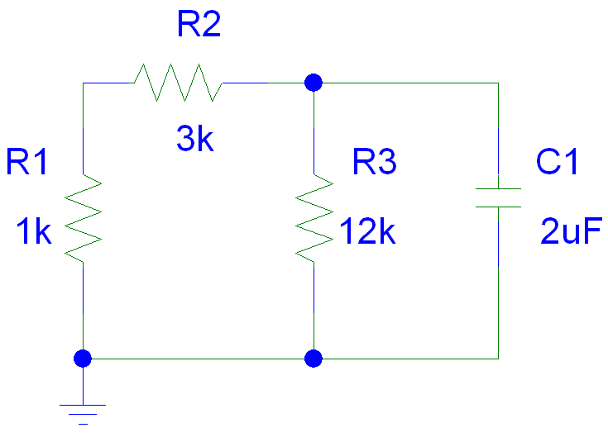
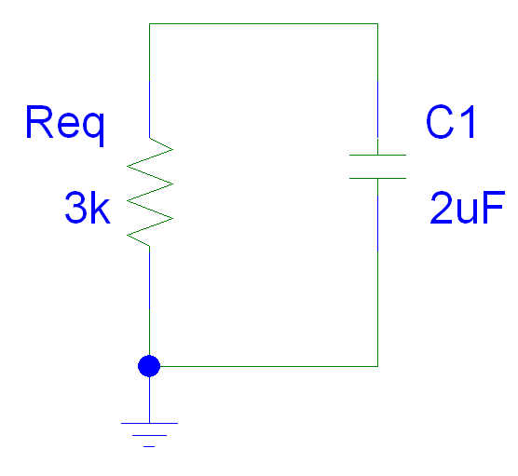
…Example 03…
t > 2ms

Slide 43
…Example 03
t > 2ms
τ = R_{eq}C = 3kΩ(2μF) = 6 ms
V_{C} = V_{C}(2ms)e^{-(t-2ms)/τ} = 4V e^{-(t-2ms)/6ms}
V_{R} = V_{C}
I_{C} = C dV_{c}/dt = 2μF(-4V/6ms) e^{-(t-2ms)/6ms}
= -1.33 e^{-(t-2ms)/6ms} mA
I_{R} = - I_{C} = 1.33 e^{-(t-2ms)/6ms} mA
Note I_{R} + I_{L} = 0 mA

Slide 44
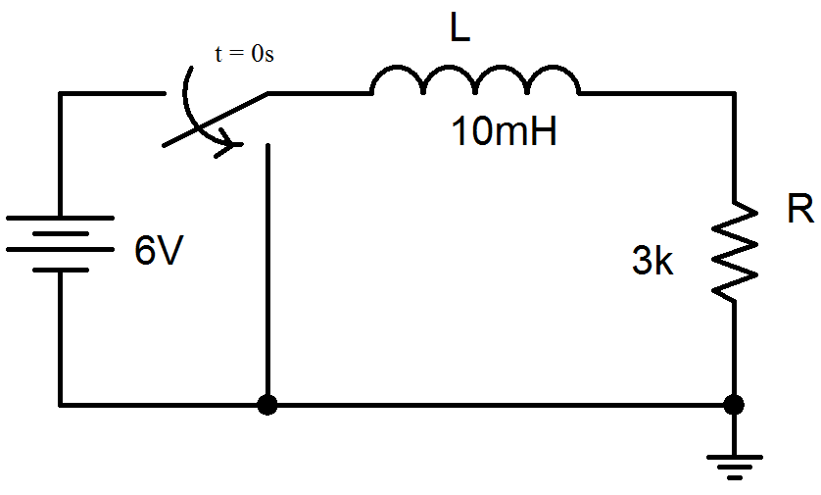
Example 04…
I_{L}(t)
V(t) = 6V [1 - u(t)]

Slide 45
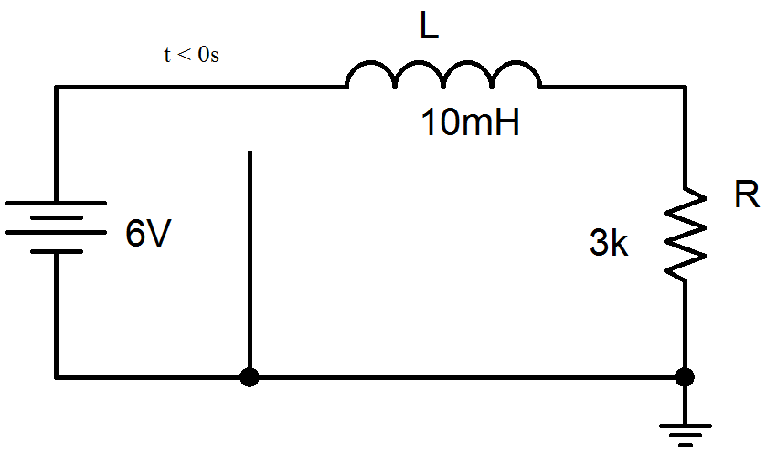
…Example 04…
I_{L}(t)

Slide 46
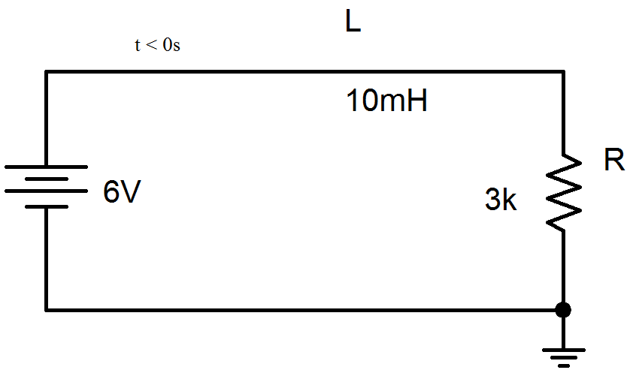
…Example 04…
Find the initial condition.
t < 0s
V_{L} = 0V
V_{R} = 6V
I_{L} = I_{R} = 2mA
Therefore,
I_{o} = 2mA
I_{o}

Slide 47
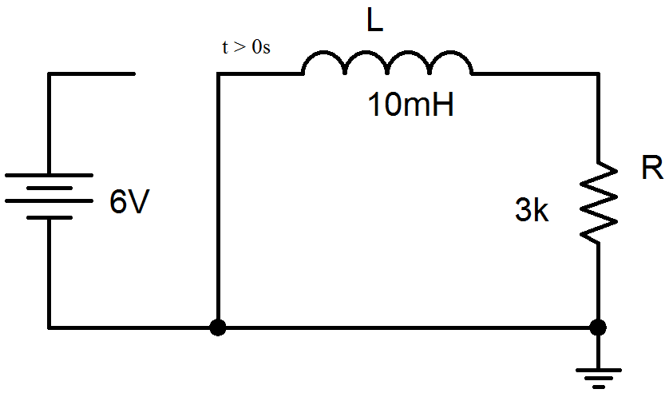
…Example 04…
I_{L}(t)

Slide 48
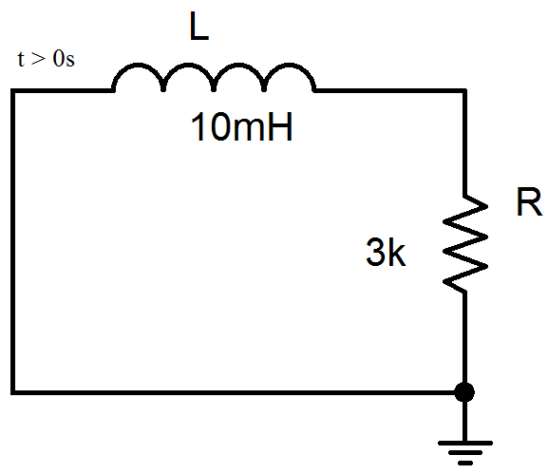
…Example 04
I_{L}(t)
t > 0s
t = L/R = 10mH/3kΩ/ = 3.33μs
I_{L} = I_{R} =I_{o}e^{-t/τ} = 2mA e^{-(t/3.33μs)}
V_{R} = 3kΩ I_{R} = 6V e^{-(t/3.33μs)}
V_{L} = L dI_{L}/dt = -6V e^{-(t/3.33μs)}
Note V_{R} + V_{L} = 0 V

