Slide 1
Lecture 6: Sampling Distributions and the Central Limit Theorem

Slide 2
Random variables
Formally, a random variable X assigns a numerical value to each possible outcome (and event) of a random phenomenon.
For instance, we can define Xbased on possible outcomes of events as follows:
0 for property AA, X = 1 for property Aa,
2 for property aa.
Alternatively, we can define a random, Y, variable this way:
₀
for property AA and aa,
Y =
1 for property Aa.

Slide 3
Random variables
After we define a random variable, we can find the probabilities for its possible values based on the probabilities for its underlying random phenomenon.
This way, instead of talking about the probabilities for different outcomes and events, we can talk about the probability of different values for a random variable.
For example, suppose P(AA) = 0.49, P(Aa) = 0.42, and
P(aa) = 0.09.
Then, we can say that P(X = 0) = 0.49, i.e., X is equal to 0 with probability of 0.49.
Note that the total probability for the random variable is still 1.

Slide 4
Random variables
The probability distribution of a random variable specifies its possible values (i.e., its range) and their corresponding probabilities.
For the random variable Xdefined, the probability distribution can be simply specified as follows:
0.49
P(X = x ) = 0.42
0.09
for x = 0, for x = 1, for x = 2.
Here, x denotes a specific value (i.e., 0, 1, or 2) of the random variable.

Slide 5
Discrete vs. continuous random variables
We divide the random variables into two major groups:
discrete and continuous.
Discrete random variables can take a countable set of values.
These variables can be categorical (nominal or ordinal), such as the number of siblings, or patients visiting an emergency room per day.
Continuous random variables can take an uncountable number of possible values.
For any two possible values of this random variable, we can always find another value between them.

Slide 6
Probability Distributions
The probability distribution for a random variable X gives
the possible values for X, and
the probabilities associated with each possible value
The methods used to specify discrete prob. distributions are similar to (but slightly different from) those used to specify continuous prob. distributions.
0.40
P(X = x ) = 0.20
0.10
0.30
for x = sarı, for x = mavi, for x = yeşil,
for x = mor.

Slide 7
Discrete probability distributions
For discrete random variables, the probability distribution is fully defined by the probability mass function (pmf).
This is a function that specifies the probability of each possible value within range of random variable.
For the example, the pmf of the random variable X
is
0.40
P(X = x ) = 0.20
0.10
0.30
for x = sarı, for x = mavi, for x = yeşil,
for x = mor.

Slide 8
Probability Mass Function

Slide 9
Probability Mass Function
Example: Suppose the random variable X is the number of rooms in a randomly chosen owner-occupied housing unit.
The distribution of X is:
Pr [X= a unit has at least 5 rooms]=?

Slide 10
Probability Mass Function
The distribution of X is:
Pr [a unit has at least 5 rooms]=?
=Pr(5 or 6 or 7) = Pr(5) + Pr(6) +Pr(7) = .210+.224+.197=.631

Slide 11
Bernoulli distribution
Binary random variables (e.g., healthy/diseased) are abundant in scientific studies.
The binary random variable X with possible values 0 and 1 has a Bernoulli distribution with parameter θ.
• Here, P(X = 1) = θ and P(X = 0) = 1 − θ.
For example,
0.2 for x = 0,
0.8 for x = 1.
P(X = x ) =
We denote this as X ∼ Bernoulli(θ), where 0 ≤ θ ≤ 1.

Slide 12
Bernoulli distribution
The mean of a binary random variable, X, with Bernoulli(θ) distribution is θ. We show this as µ = θ.
The variance of a random variable with Bernoulli(θ) distribution is σ² = θ(1 − θ) = µ(1 − µ).
The standard deviation is obtained by taking the square root of variance:
σ = θ(1 − θ) = µ(1 − µ).
$$√$$
$$√$$

Slide 13
Binomial distribution
A sequence of binary random variables X₁, X₂, . . . , X_{n} is called Bernoulli trials if they all have the same Bernoulli distribution and are independent.
The random variable Y representing the number of times the outcome of interest occurs in n Bernoulli trials (i.e., the sum of Bernoulli trials) has a Binomial(n, p) distribution.
The pmf of a binomial(n, p) specifies the probability of each possible value (integers from 0 through n) of the random variable.

Slide 14
Binomial Distribution
,where
Notes:
Uniform distribution
In probability theory and statistics, the discrete uniform distribution is a symmetric probability distribution whereby a finite number of values are equally likely to be observed; every one of n values has equal probability 1/n. Another way of saying "discrete uniform distribution" would be "a known, finite number of outcomes equally likely to happen“
Binomial Distribution
given that you have n buckets and put k things in them without differentiating
Choose k things from n things
n = total number
k = number we want
The formula can be understood as follows: we want exactlyk successes (p^{k}) and n − k failures (1 − p)^{n − k}. However, the k successes can occur anywhere among the n trials, and there are different ways of distributing k successes in a sequence of n trials
"Bi" means "two" (like a bicycle has two wheels) ... so this is about things with two results.
We say the probability of a four is 1/6 (one of the six faces is a four). And the probability of not four is 5/6 (five of the six faces are not a four)
Can we get the 0.147 from a formula? What we want is "two 0.7s and one 0.3"
0.7 is the probability of each choice we want, call it p
2 is the number of choices we want, call it k
Probability of "choices we want" (two chickens) is: p^{k}
And
The probability of the opposite choice is: 1-p
The total number of choices is: n
The number of opposite choices is: n-k
Probability of "opposite choices" (one beef) is: (1-p)^{(n-k)}

Slide 15
Example:
2092 adult passengers on the Titanic;
654 survived Proportion of survivors = 654/2092
≅ 0.3

Slide 16
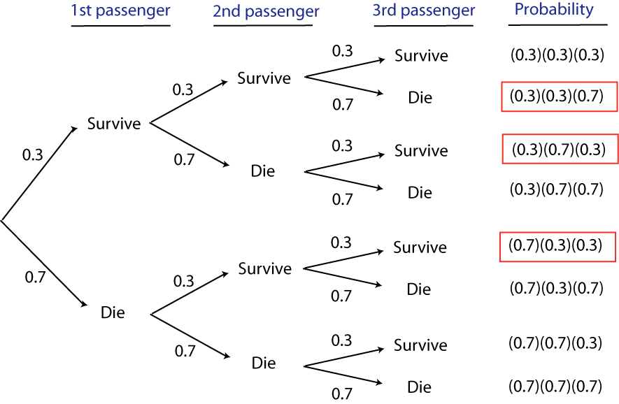
Probability that two out of three randomly chosen passengers survived the Titanic

Slide 17
Probability that two out of three randomly chosen passengers survived the Titanic
Pr[2] = ( ) (0.3) (1− 0.3)
3
2
3− 2
2
3!
=
(0.3)² (0.7)¹
2!×1!
= 3(0.3)² (0.7) = 0.189

Slide 18
Binomial Distribution Example
Example: Each child born to a particular set of parents has probability 0.25 of having blood type 0. If these parents have 5 children, what is the probability that exactly 2 of them have type 0 blood?
Let X= the number of children
Notes:
Example
Suppose a biased coin comes up heads with probability 0.3 when tossed. What is the probability of achieving 0, 1,..., 6 heads after six tosses?
Number of outcomes * we want Probability of each outcome

Slide 19
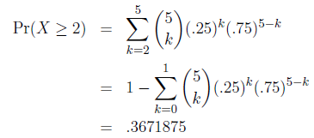
Binomial Distribution Example
What is the expected number(average) of children with type 0 blood?
μ = 5(0.25) = 1.25
What is the probability of at least 2 children with type 0 blood?

Slide 20
Example: Flight Simulator
The probability of successfully landing a plane using
a flight simulator is given as 80%. Five randomly and independently chosen student pilots are asked to try to fly the plane using the simulator
What is the chance that 3 of those students land successfully and 2 of them fail?

Slide 21
p = 0.8
n = 5
X = 3
5
Pr[3] = ( ) 0.8³(1 − 0.8)⁵⁻³
120
3
=
0.8³(0.2)² = 0.205
6 × 2

Slide 22
Exercise:
What is the probability that 3 or more of them are successful?

Slide 23
Poisson Distribution
The Poisson distribution describes the probability that a certain number of events occur in a block of time or space, when those events happen independently of each other and occur with equal probability at every point in time or space.
Useful in studying rare events
Poisson distribution approximates the binomial distribution when n is large and p is small

Slide 24
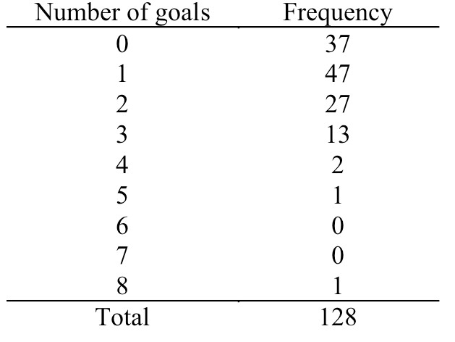
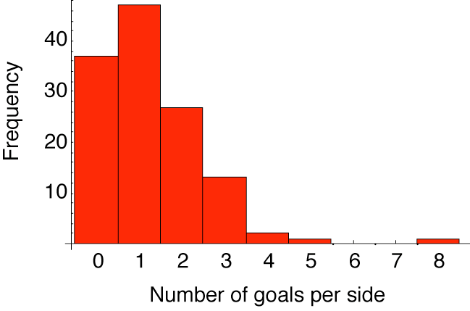
Example: Number of goals per side in World Cup Soccer
Q: Is the outcome of a soccer game (at this level) random?
Poisson distribution
−μ X
Pr[X ] = ^{e μ}
X!
In other words, is the number of goals per team distributed as expected by pure chance?
Number of goals for a team (World Cup 2002)
World Cup 2002 scores

Slide 25
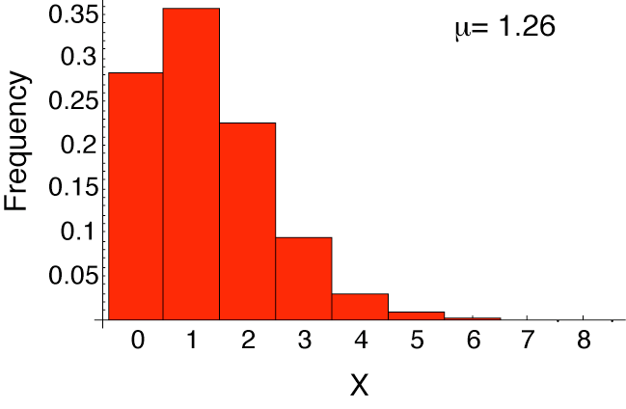
What’s the mean, μ?
Poisson with μ = 1.26
37(0) + 47(1) + 27(2) + 13(3) + 2(4) + 1(5) + 1(8)
x =
128
−μ X −1.26
2
_{Pr[2] =} e μ ₌ e (1.26) ₌ (0.284)1.59 _{= 0.225}
₌ 161
128
= 1.26
X! 2! 2
Poisson with μ = 1.26
X | Pr[X]
0 | 0.284
1 | 0.357
2 | 0.225
3 | 0.095
4 | 0.030
5 | 0.008
6 | 0.002
7 | 0
#8 | 0

Slide 26
Continuous probability distributions
For discrete random variables, the pmf provides the probability of each possible value.
For continuous random variables, the number of possible values is uncountable, and the probability of any specific value is zero.
For these variables, we are interested in the probability that the value of the random variable is within a specific interval from x₁ to x₂; we show this probability as P(x₁ < X ≤ x₂).

Slide 27
Probability density function
For continuous random variables, we use probability density functions (pdf) to specify the distribution. Using the pdf, we can obtain the probability of any interval.
0.08
0.06
Density
0.04
0.02
0.00
10
20
30
40
X
Figure: Probability density function for BMI

Slide 28
Probability density function
The total area under the probability density curve is 1.
The curve (and its corresponding function) gives the probability of the random variable falling within an interval.
This probability is equal to the area under the probability density curve over the interval.
0.08
0.06
Density
0.04
0.02
0.00
10
20
30
40
X

Slide 29
Continuous Random Variable
f(x) - Probability density function for a continuous random variable X
Properties
Important Notes

Slide 30
Probability of intervals
The probability of any interval from x₁ to x₂, where x₁ < x₂, can be obtained using the corresponding lower tail probabilities for these two points as follows:
P(x₁ < X ≤ x₂) = P(X ≤ x₂) − P(X ≤ x₁).
For example, the probability of a BMI between 25 and 30 is
P(25 < X ≤ 30) = P(X ≤ 30) − P(X ≤ 25).

Slide 31
Normal distribution
This distribution is known as normal distribution, which is one of the most widely used distributions for continuous random variables.
Also known as the Gaussian distribution
Random variables with this distribution (or very close to it) occur often in nature.

Slide 32
Normal distribution
A normal distribution and its corresponding pdf are fully specified by the mean µ and variance σ².
A random variable X with normal distribution is denoted
X ∼ N(µ, σ²).
N(0, 1) is called the standard normal distribution.
0.4
N(1, 4)
N(−1, 1)
0.3
Density
0.2
0.1
0.0
−6 −4 −2 0 2 4 6 8
X

Slide 33
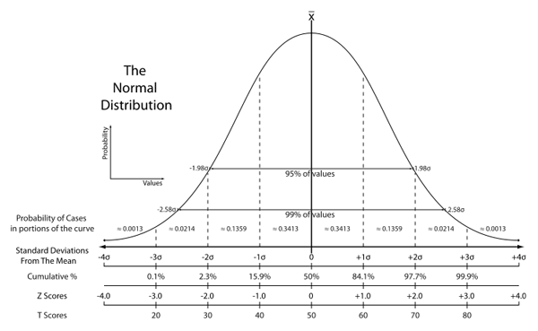
Normal Distribution
Symmetric

Slide 34
Normal Distribution

Slide 35
Standard Normal Distribution
A normal distribution with mean 0 and variance 1 is called a standard normal distribution.
Standard normal probability density function
Standard normal cumulative probability function
Let Z ~ N(0, 1)
Symmetry property

Slide 36
Cumulative distribution function
by using lower tail probabilities, we can find the probability of any given interval.
Indeed, all we need to find the probabilities of any interval is a function that returns the lower tail probability at any given value of the random variable: P(X ≤ x ).
This function is called the cumulative distribution function
(cdf) or simply the distribution function.

Slide 37
Quantiles
We can use the cdf plot in the reverse direction to find the value of the random variable for a given lower tail probability.
1.0
1.0
0.8
0.8
Cumulative Probability
Cumulative Probability
0.6
0.6
0.4
0.4
0.2
0.2
0.0
0.0
−4 | −2 | 0 | 2 | 4 | −4 | −2 | 0 | 2 | 4
 |  | X |  |  |  |  | X
Figure: Left: Finding lower tail probabilities. Right: Finding quantiles

Slide 38
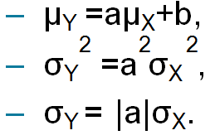
Scaling and shifting random variables
If Y = aX + b, then
The process of shifting and scaling a random variable to create a new random variable with mean zero and variance one is called standardization.
For this, we first subtract the mean µ and then divide the result by the standard deviation σ.
X − µ σ
Z =
.
• If X ∼ N(µ, σ²), then Z ∼ N(0, 1).

Slide 39
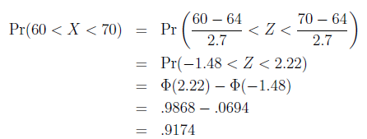
Standardization

Slide 40
Adding/subtracting random variables
If W = X + Y , then
µ_{W} = µ_{X} + µ_{Y .}
If the random variables X and Y are independent (i.e., they do not affect each other probabilities), then we can find the variance of W as follows:
_{σ}2
2 2
_{W} = σ_{X} + σ_{Y} .
2
2
If X ∼ N(µ ,σ ) and Y ∼ N(µ ,σ ), then assuming that
X
Y
X Y
the two random variables are independent, we have;
2 2
W = X + Y ∼ N µ + µ , σ + σ .
X Y X Y

Slide 41
Adding/subtracting random variables
If we subtract Y from X, then
µ_{W} = µ_{X} − µ_{Y} .
If the two variables are independent,
_{σ}2
2 2
_{W} = σ_{X} + σ_{Y} .
Note that we still add the variances.
Subtracting Y from X is the same as adding −Y to X .

Slide 42
Central limit theorem
Repeated sampling with replacement gives a distribution of sample means which is normally distributed and with a mean which is the true population mean, μ
Assumptions:
Large and constant sample size
Repeated sampling with replacement
Samples are randomly taken

Slide 43
Central Limit Theorem

Slide 44
A larger sample has a lower standard error

Slide 45
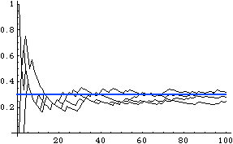
The law of large numbers
The greater the sample size, the closer an estimate of a proportion is likely to be to its true value.
pˆ
Sample size

